Slide 1
Bug Bytes
Milestone 3 Presentation
Polus Banyameen, Maria Leon, Sydney Lum, Steven Mondoux

Slide 2
Project Details
Bug bytes is a web application designed to help introduce people to coding, and give lessons.
Different types of questions (Multiple choice, sample code, etc.)
Their progress is tracked through their account, saved on MySQL, with servers hosted by Apache Maven.
The user is also given an ape companion to help them throughout their lessons
Can customize with coins earned through play time.

Slide 3
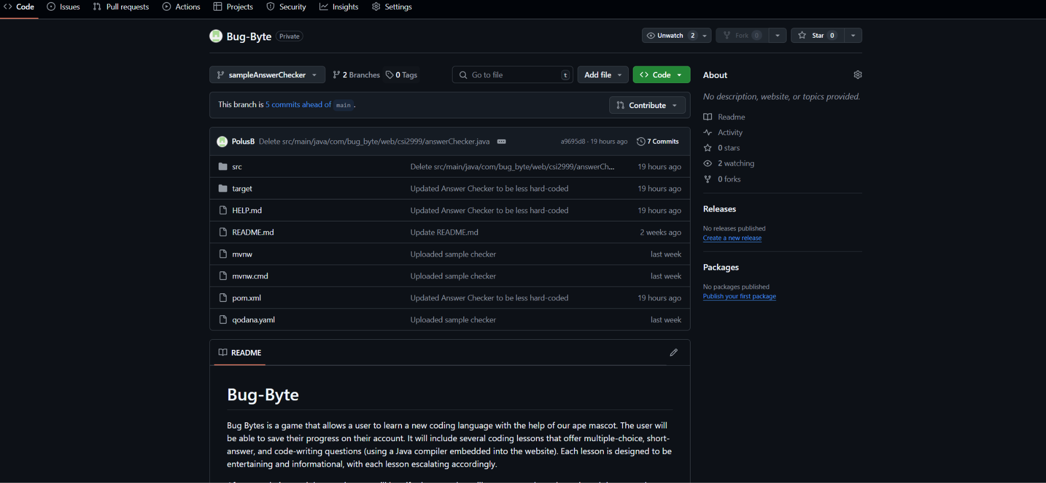
What we have left to do
Account registration
Login functionality
Shop feature
Finalizing the site pages (homepage, login, lesson, shop)
Designing cosmetics, apes, GIFs
Complete matching question prompts
Frontend (JavaScript, HTML, and CSS)
Complete creating and coding lesson plans
Saving progress locally
Implementing the front-end with the site pages
Run through the project and demo it to see if there are any bugs.

Slide 4
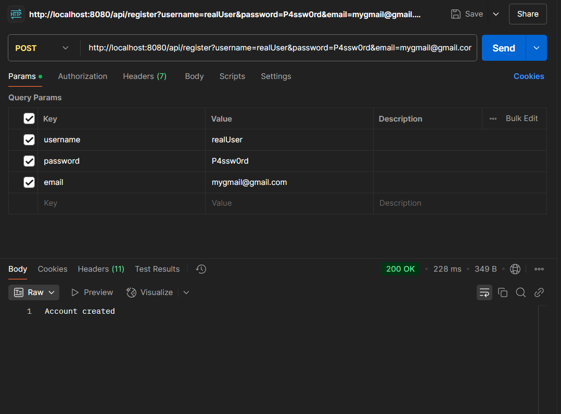
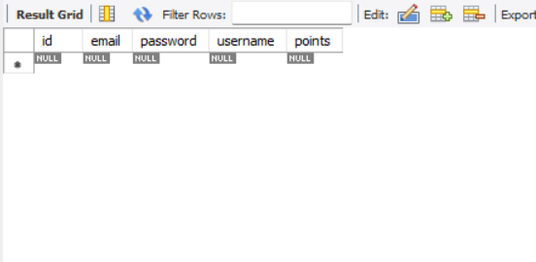
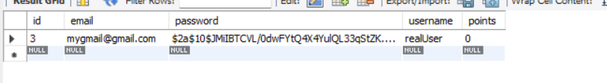
Demo (Registering)

Slide 5
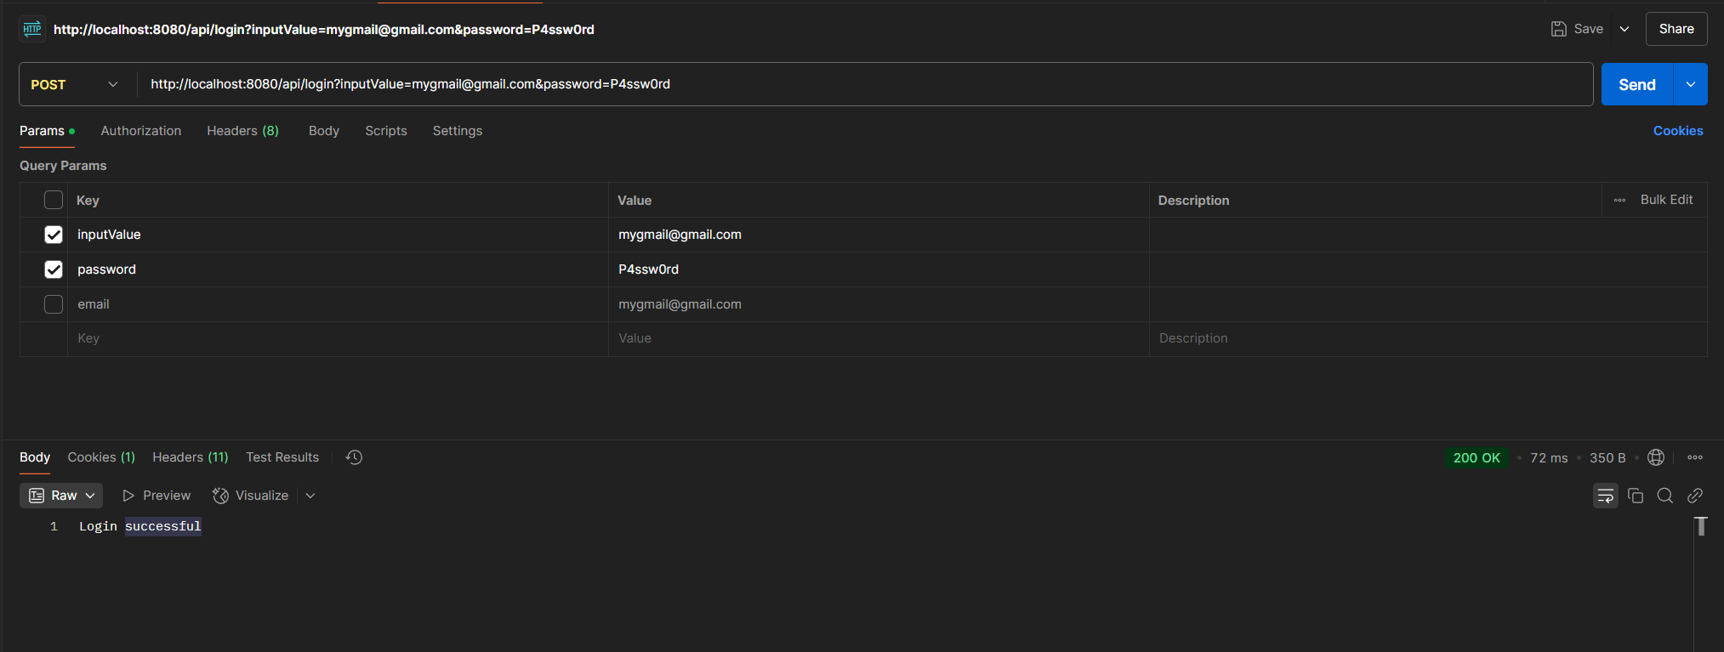
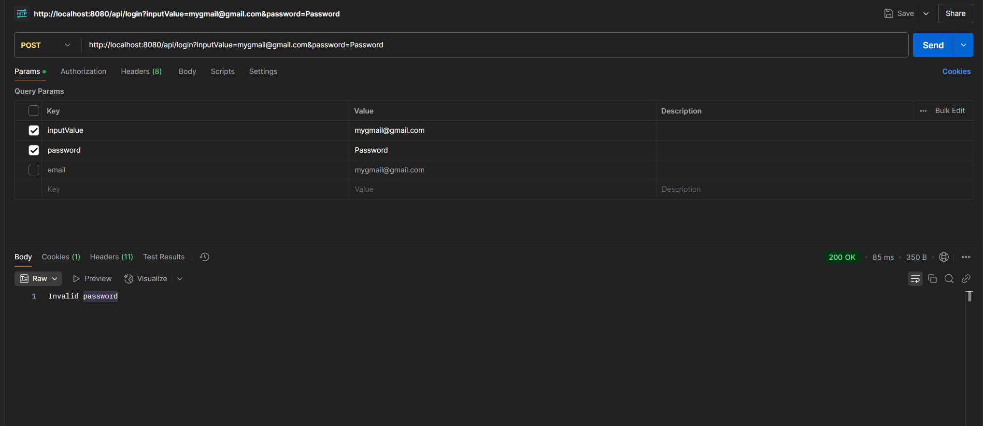
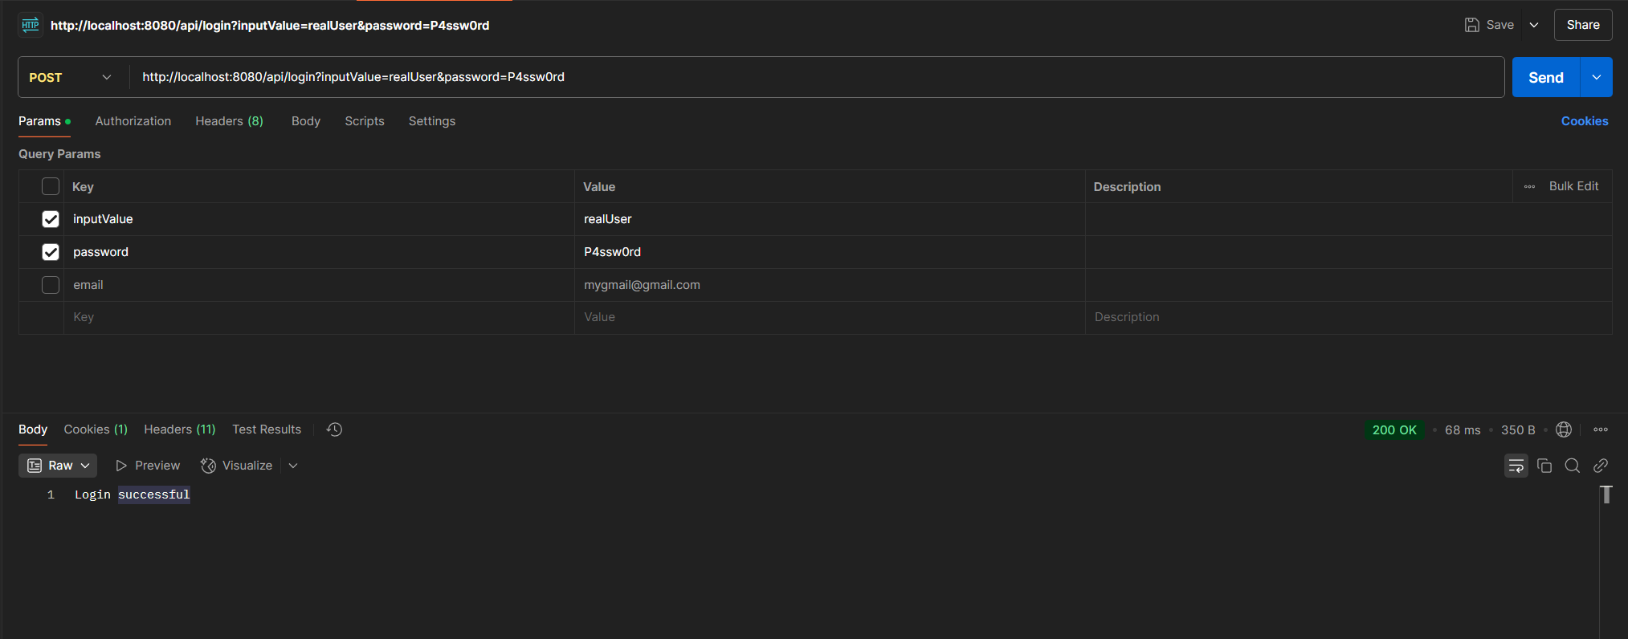
Demo (Logging In)

Slide 6
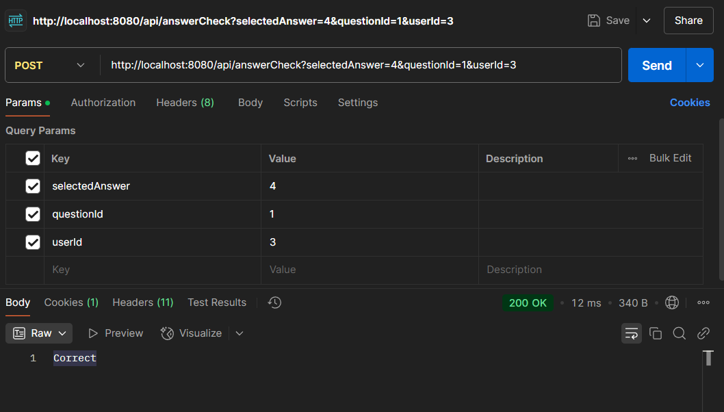
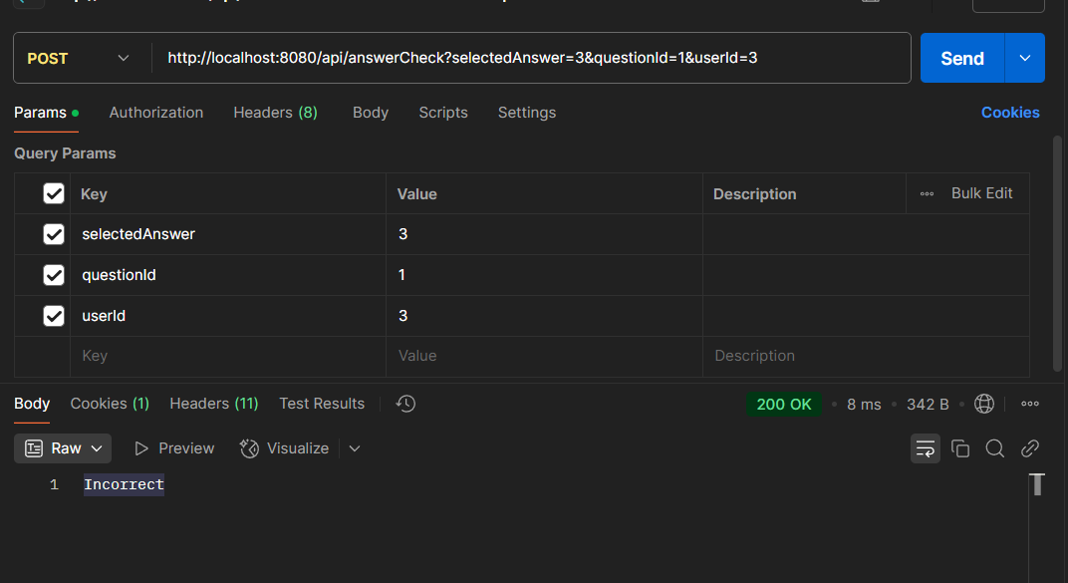
Demo (Answer Checking)

Slide 7
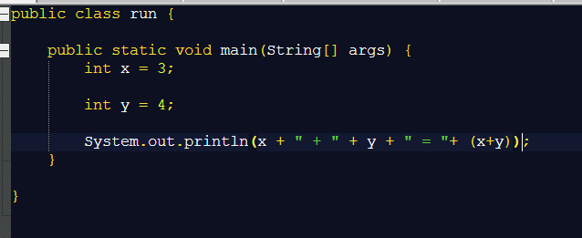

Demo (Code Output/Requirement Check)

Slide 8


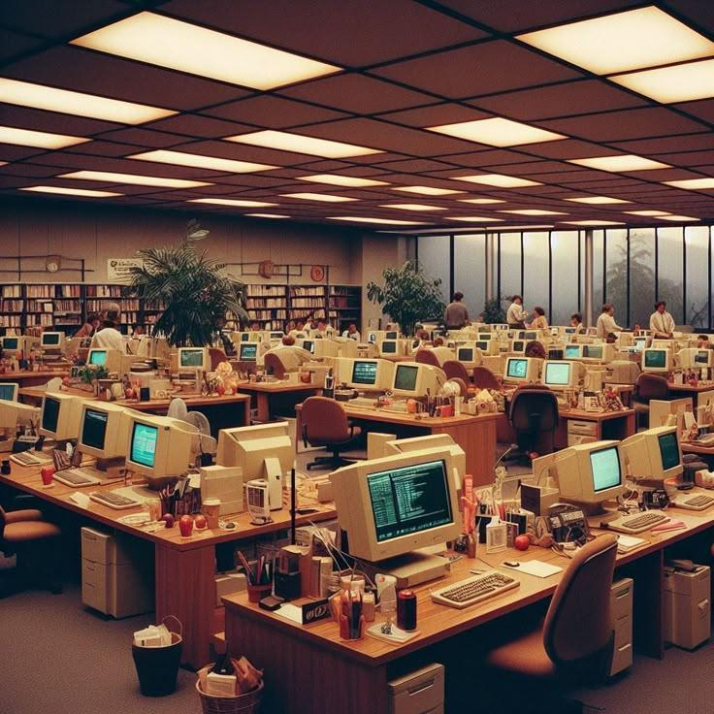
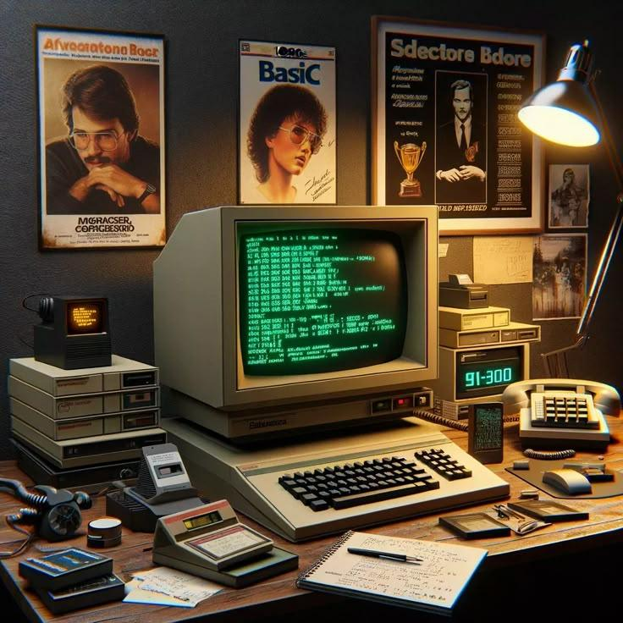
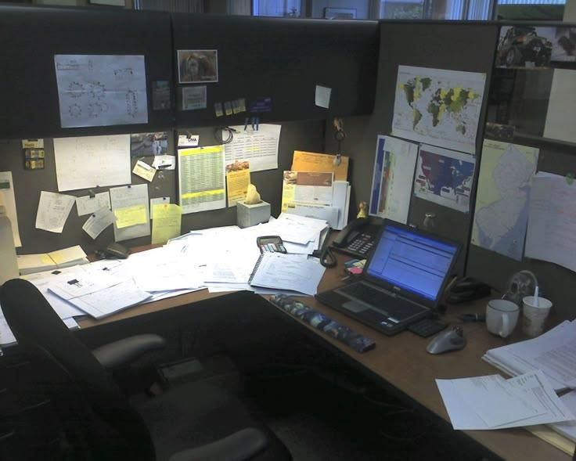

Slide 9
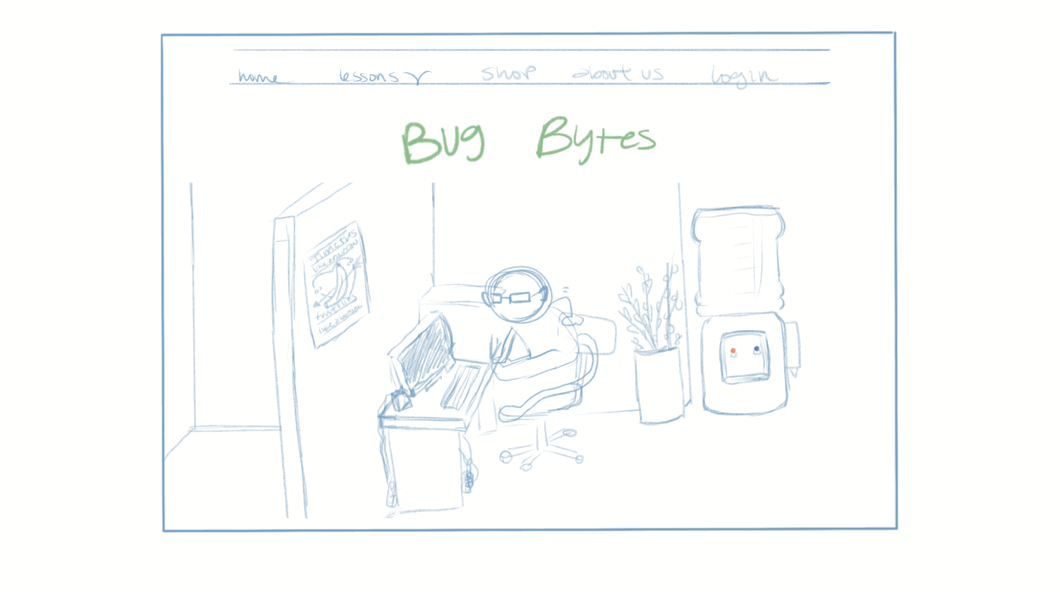
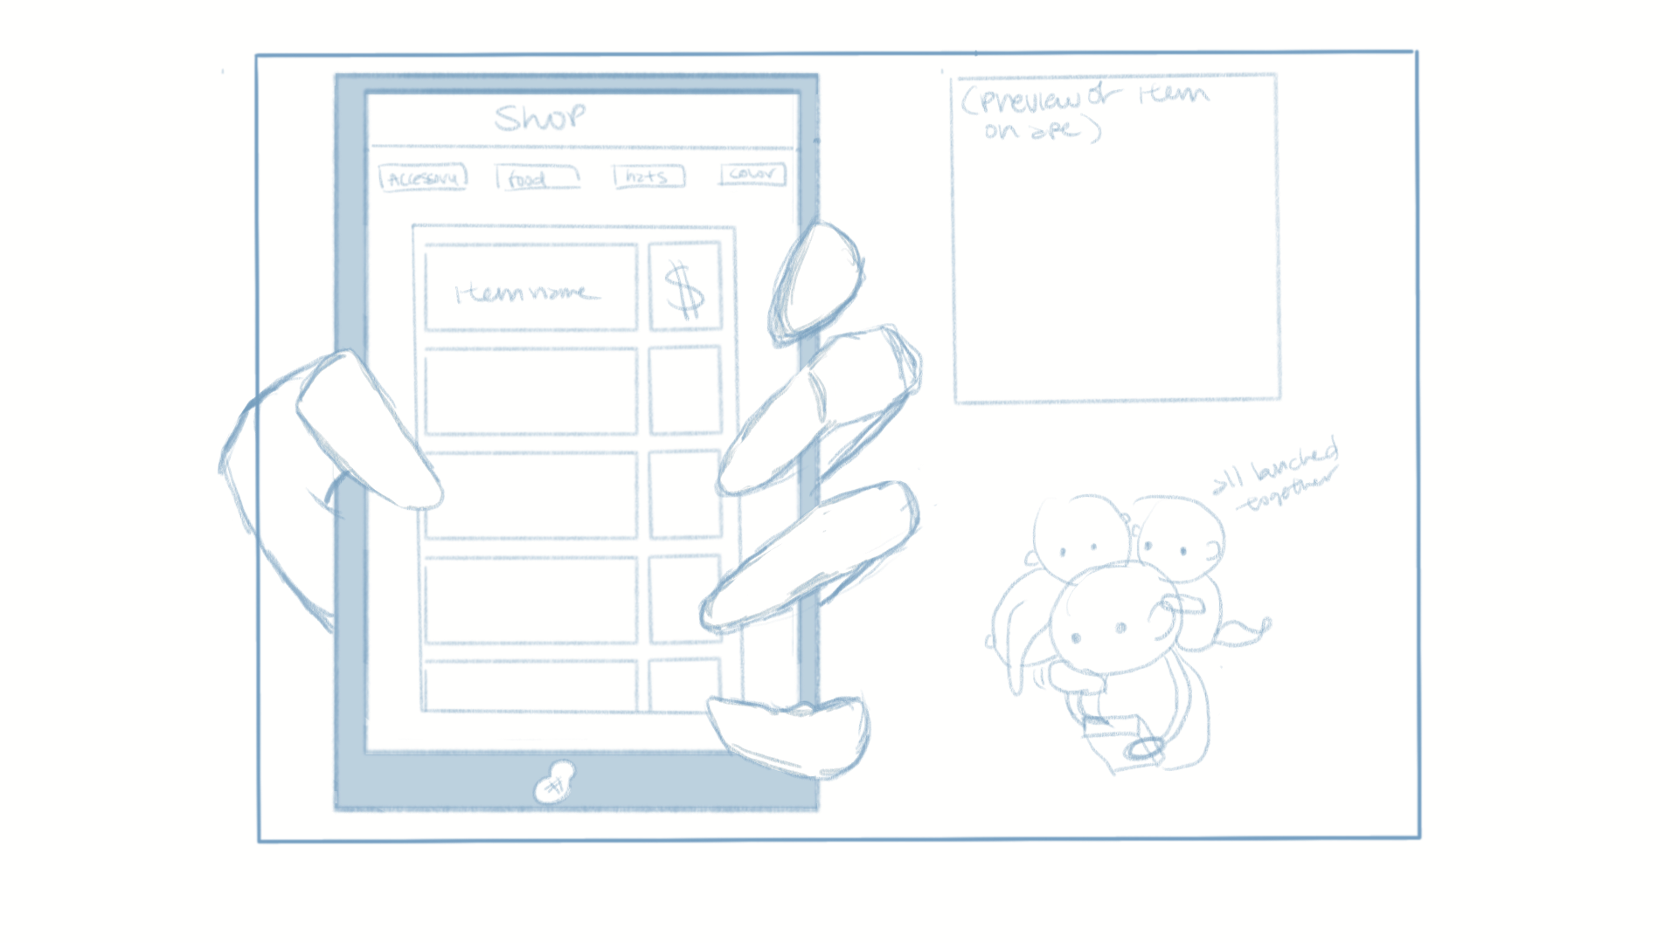
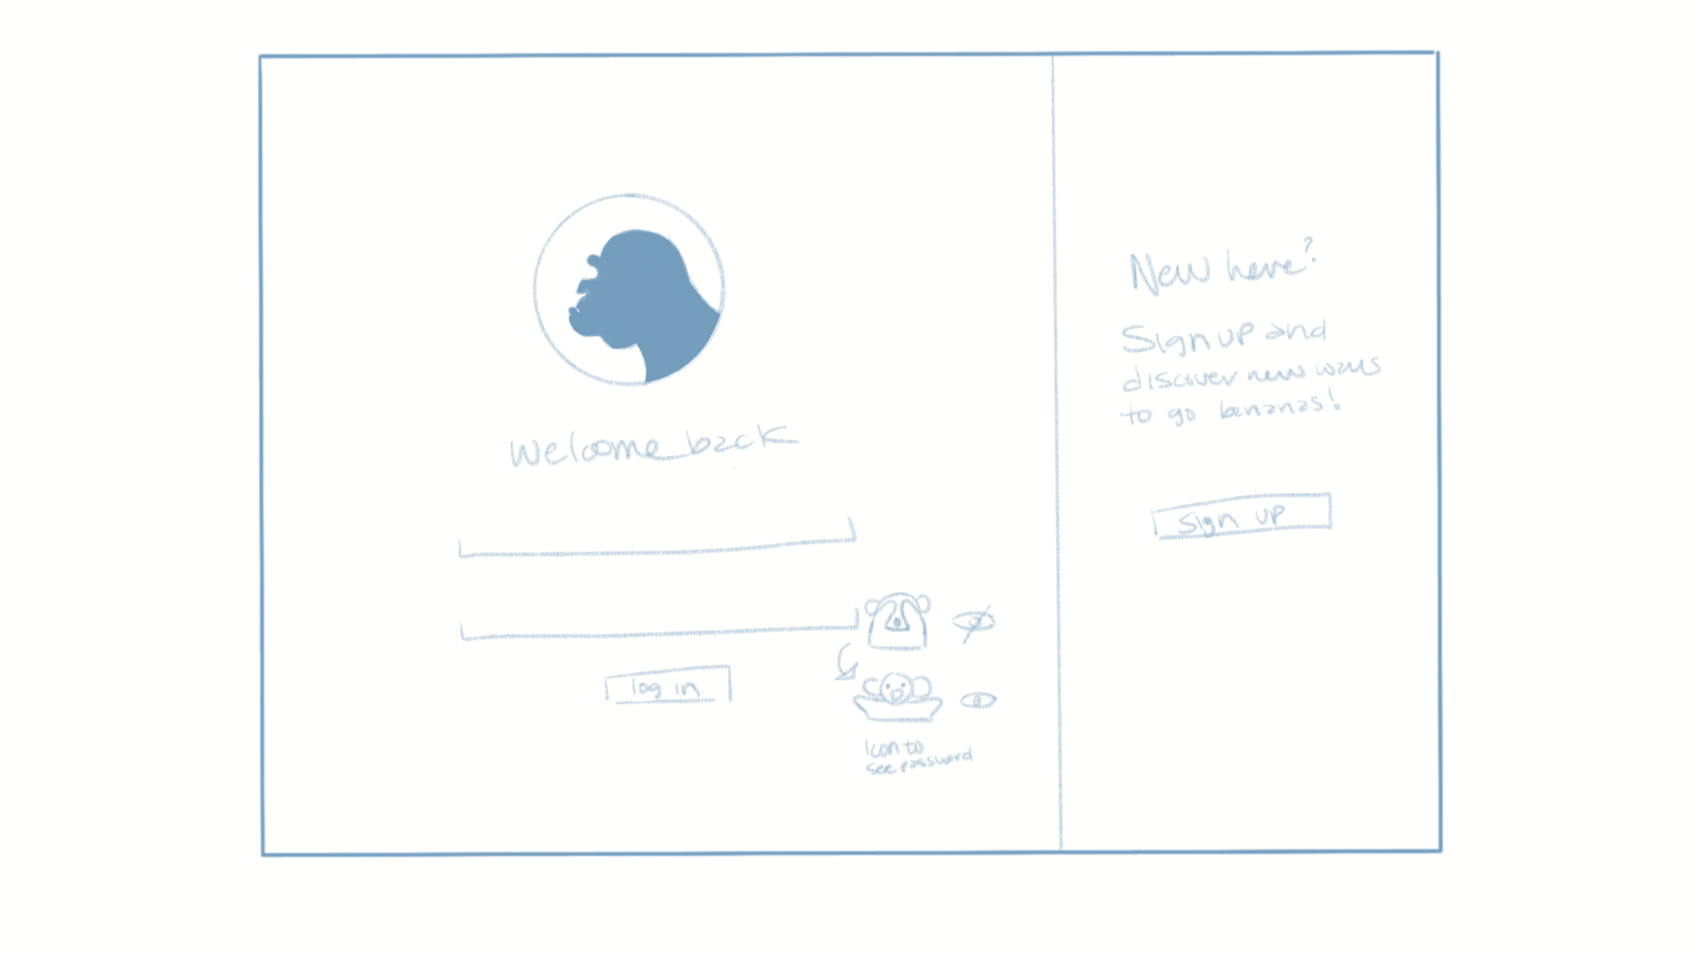
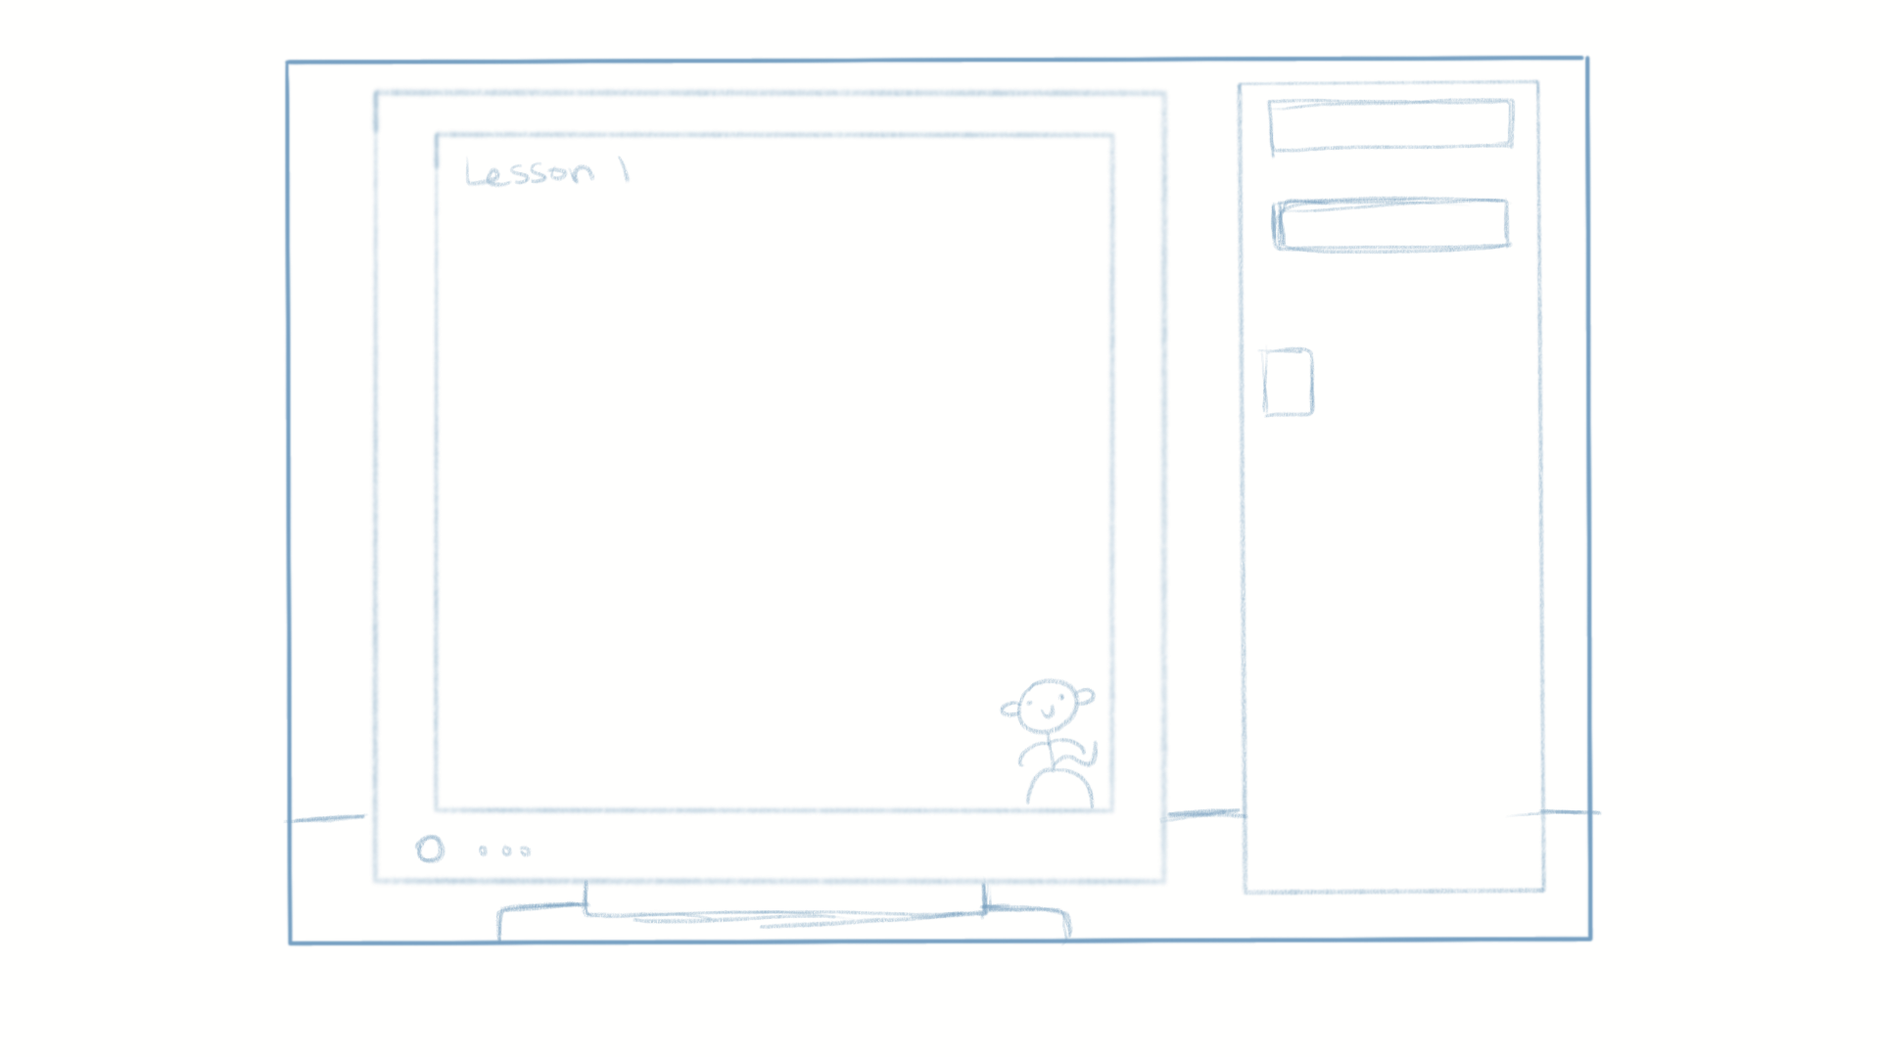

Slide 10




Baboon
Macaques
Gorilla

Slide 12

